Slide 1
SIT323 Cloud Application Development
Class 9 – Cloud Programming

Slide 2
Content
AWS https://aws.amazon.com/
Free Account
AWS Educate https://www.awseducate.com/
Management Console – Sign In
Auto Scaling – Assignment
Application Load Balancing – Assignment
SIT323 - Deakin University - 2019
Page 2

Slide 3
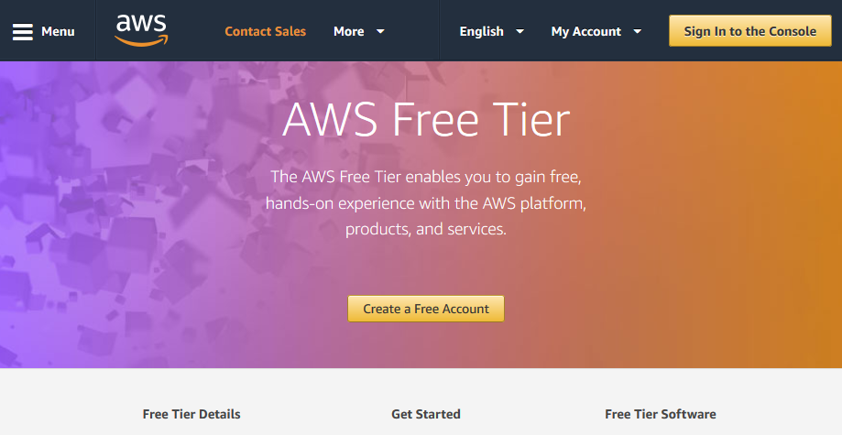
Free Account
https://aws.amazon.com/free/
SIT323 - Deakin University - 2019
Page 3

Slide 4
Management Console
https://aws.amazon.com/console/
This is one place where you can login.
After login, many services are available such as:
compute: EC2, Elastic Beanstalk, …
storage: S3, EFS, …
database: RDS, DynamoDB, …
networking: VPC, Route 53, …
developer tools: Cloud9, CloudStar, …
and many more
SIT323 - Deakin University - 2019
Page 4

Slide 5
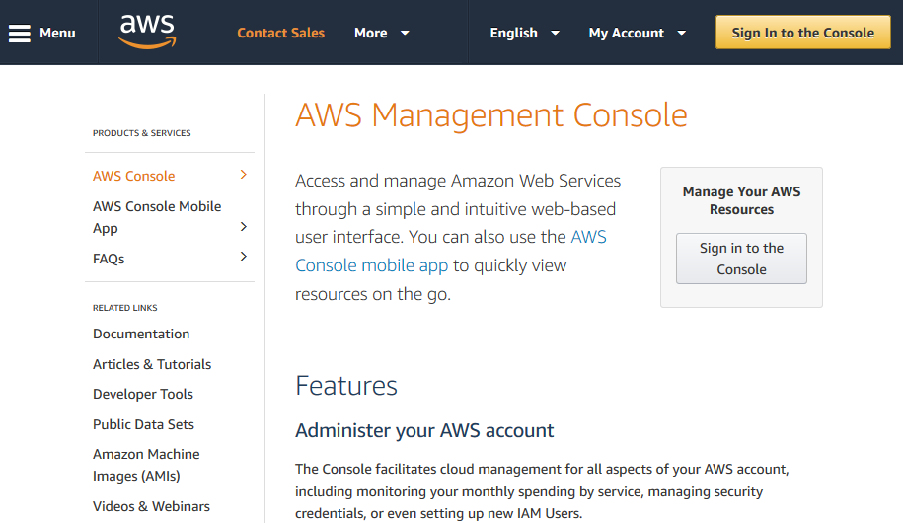
Management Console – Sign In
https://aws.amazon.com/console/
SIT323 - Deakin University - 2019
Page 5

Slide 6
Auto Scaling – Assignment
Auto Scaling is unfortunately unavailable in AWS Educate.
For each application (TestA, TestB, and TestC), use at least 2 VMs.
SIT323 - Deakin University - 2019
Page 6

Slide 7
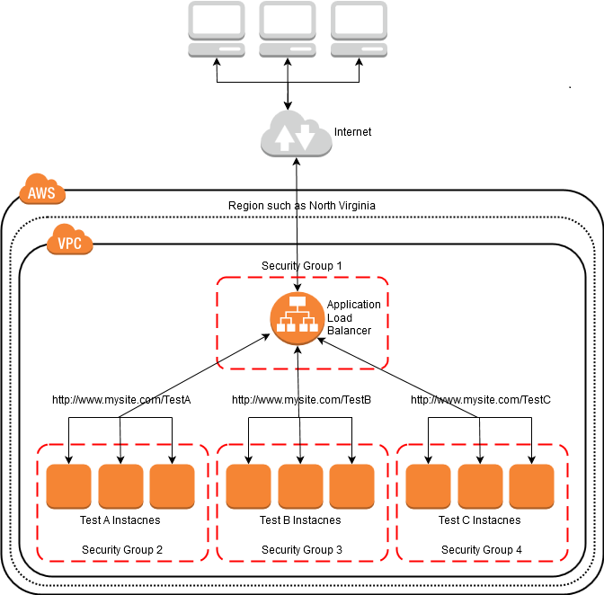
Cloud Application (Excel)
SIT323 - Deakin University - 2019
Page 7

Slide 8
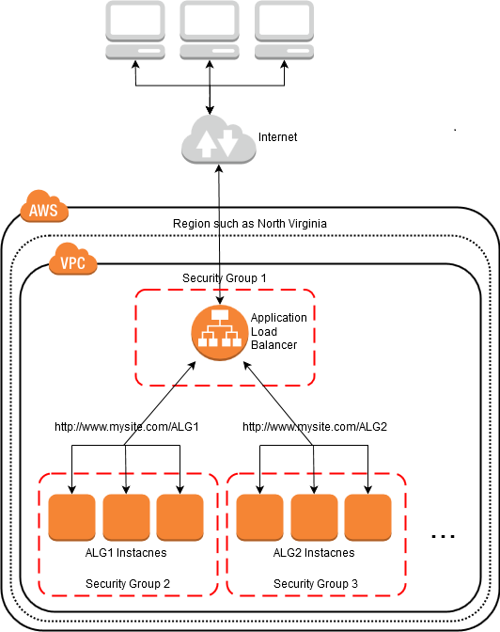
Cloud Application (C#)
This architecture depicts 2 applications: one for ALG1, the other for ALG2.
Your software might include several applications, one for each algorithm.
One WCF Service can be deployed to each VM in ALG1.
Another WCF Service can be deployed to each VM in ALG2.
SIT323 - Deakin University - 2019
Page 8

Slide 9
Application Load Balancing (Excel DEMO)
create security groups (DemoAsg, DemoBsg, DemoCsg, DemoPublicsg)
for each application X in (DemoA, DemoB, DemoC)
create VM for application X (to create AMI)
install IIS web server
update default web page (include an ID such as Application = Demo A)
create new folder (such as DemoA) in wwwroot for our HTML files
create AMI (such as DemoAim)
create all VMs for application X using the AMI (such as DemoAim)
create target groups (DemoAtg, DemoBtg, DemoCtg)
register VMs to target groups
ensure all target VMs in each target group are healthy
create load balancer (Demolb)
add rules (PATH, Forward to target group)
ensure all target groups refer to the load balancer
test load balancer - use DNS Name of load balancer and ensure forwarding is working
SIT323 - Deakin University - 2019
Page 9

Slide 10
Summary
AWS https://aws.amazon.com/
Free Account
AWS Educate https://www.awseducate.com/
Management Console – Sign In
Auto Scaling – Assignment
Application Load Balancing – Assignment
SIT323 - Deakin University - 2019
Page 10

